Slide 1


Automatic Numberplate Recognition (ANPR)
Automatic Numberplate Detection (ANPR) using Deep Learning is an advanced system that automates the process of reading vehicle license plates. It has extensive applications in law enforcement, traffic management, and parking systems.

Slide 2

Overview of Deep Learning in ANPR
1
ANPR Features
Deep learning enhancements include accurate plate location and recognition of various plate formats.
2
Training Data
High-quality datasets for deep learning models consist of diverse license plate images.
3
Integration
Deep learning is integrated with ANPR systems to improve accuracy and efficiency.

Slide 3

Training a deep learning model for ANPR
Data Collection
Model Architecture
Hyperparameter Tuning
Collecting a comprehensive dataset of license plate images from various sources is crucial.
Development of a convolutional neural network (CNN) with robust feature extraction for plate recognition.
Optimizing learning rates, batch sizes, and epochs to fine-tune the model's performance.

Slide 4
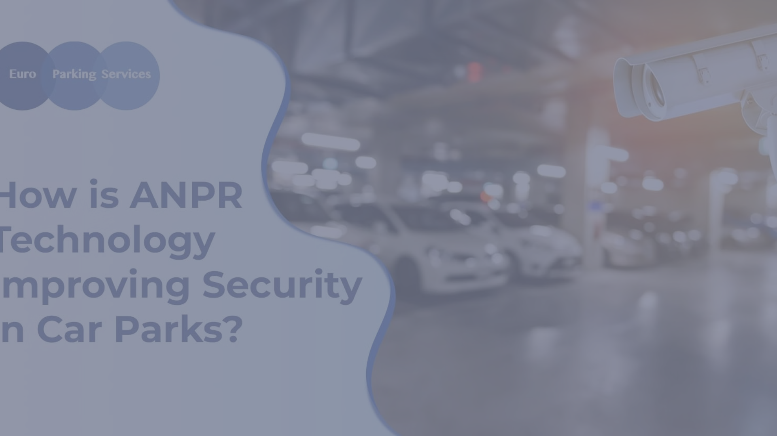
Techniques for improving ANPR accuracy
1
Data Augmentation
2
Ensemble Methods
3
Quality Assurance
Generating additional training images through rotation, scaling, and color manipulation.
Implementing multiple deep learning models to enhance the identification of license plates.
Regular validation and testing to ensure reliable ANPR performance in diverse conditions.

Slide 5




Real-world applications of ANPR using deep learning
Law Enforcement
Traffic Management
Parking Systems
Identification of stolen or wanted vehicles in real-time for enhanced public safety.
Monitoring congested areas and detecting traffic violations for smoother flow and safety.
Efficient access control and automated payment processing in parking facilities.

Slide 6


Automatic Number Plate Recognition System Using Optical Character Recognition
Year: 2017
Algorithms Used: Optical Character Recognition (OCR), Artificial Neural Networks (ANN), k-Nearest Neighbor (kNN)
Challenges Faced:
Variability in number plate formats and environments affecting accuracy.
Performance degradation with blurred or skewed number plate images.
Efficient positioning of ANPR cameras to capture clear snapshots.
Recognition limitations with plates in difficult surroundings.
Balancing recognition accuracy and computational efficiency in real-time processing.

Slide 7

Challenges and limitations of ANPR using deep learning
Data Quality
Variances in image quality and insufficient data pose challenges to deep learning models.
Environmental Factors
Weather and lighting conditions impact the accuracy of number plate detection systems.
Privacy Concerns
Addressing the ethical implications of widespread license plate surveillance.

Slide 8
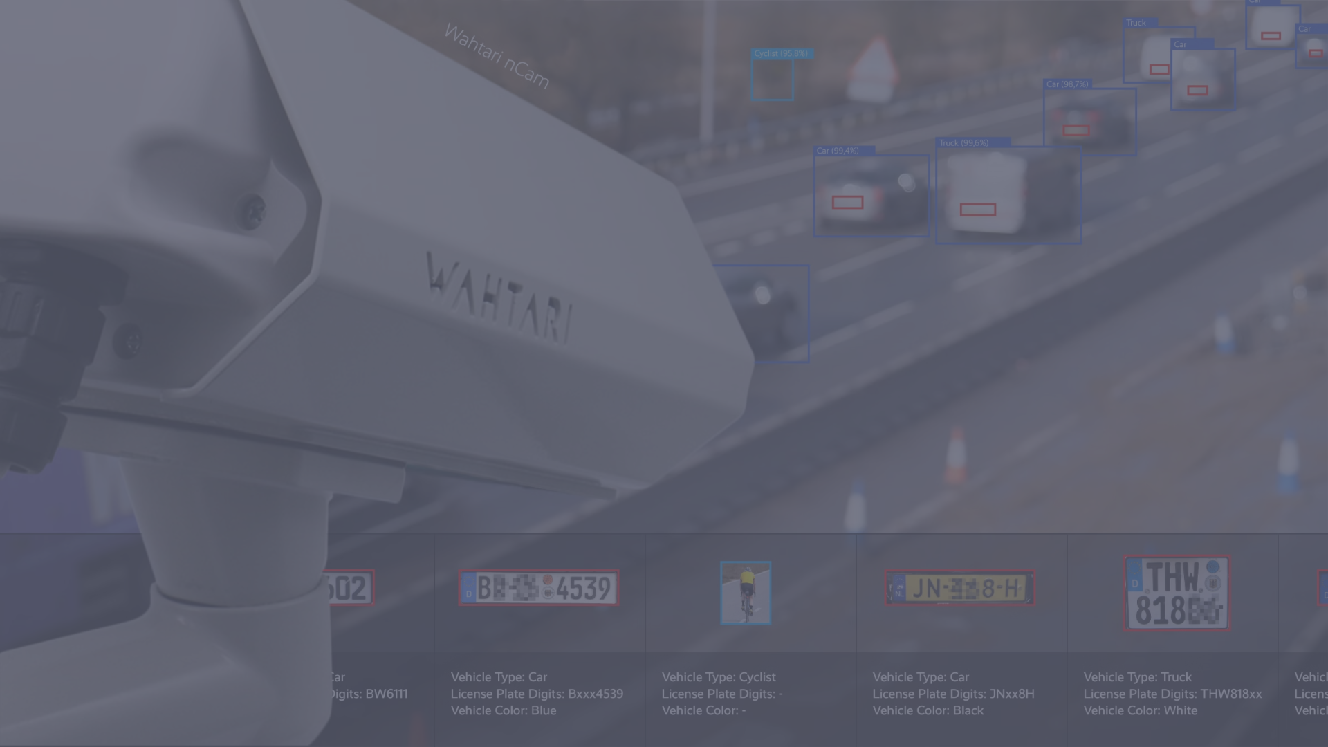
Future directions and advancements in ANPR using deep learning
Enhanced Accuracy
AI-assisted Law Enforcement
Blockchain Integration
Integration of multimodal input, including video and sensor data, for precise plate recognition.
Development of intelligent systems for predictive analysis and pattern recognition in criminal investigations.
Exploration of secure and decentralized frameworks for ANPR data management.

